Slide 1

Geo-located point data: measurement of agglomeration and concentration
Katarzyna Kopczewska Faculty of Economic Sciences, University of Warsaw kkopczewska@wne.uw.edu.pl

Slide 2
My presentation
Data analyst and economist persepective
Spatial statistics problems applied to economy and economics (scientific theoretical research and empirical studies)
Applied to cohesion policy, business location, core-peripery models etc.
In fact: like Gumtree announcement – I am looking for package developer to cover the ideas expressed here (and more) ☺
(I am too busy for this...)

Slide 3
An approach to points (1)
Let’s start with quite simple data set on firms like below:
As e.g. REGON dataset (geolocated firms with some characteristics
ID | xgeo | ygeo | sector | Employment
1001 | 52,489 | 18,175 | A | 50
1002 | 52,189 | 17,495 | G | 100
1003 | 51,752 | 19,856 | B | 10
1004 | 53,415 | 18,423 | A | 50
… | … | … | … | …

Slide 4
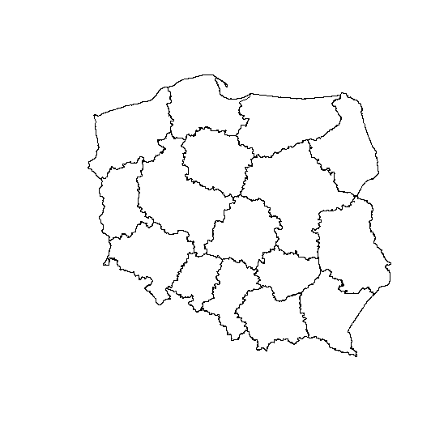
An approach to points(2)
… and a shapefile
for territory
analysed
What we can do with this?

Slide 5
R code – read data and map
library(spdep)
library(rgdal)
library(maptools)
library(sp)
# reading shapefiles from Working Directorys (rgdal package)
woj<-readOGR(".", "wojewodztwa") # 16 spatial units
pow<-readOGR(".", "powiaty") # 380 spatial unirts
projekcja<-"+proj=longlat +datum=WGS84" # defines the projection
woj <- spTransform(woj, CRS(projekcja)) # converts the map
pow <- spTransform(pow, CRS(projekcja))
# reading panel dataset (units in the same order as in shapefile)
dane<-read.csv("geoloc data.csv", header=TRUE, sep=";", dec=".")

Slide 6
In many cases
the begin and the end of analysis
is ….. the map

Slide 7
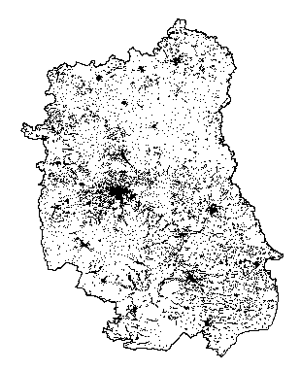
Mapping (1) Point data
woj.df<-as.data.frame(woj) # to make dbf file easy to use
region<-woj[woj.df$jpt_nazwa_=="lubelskie",]
projekcja<-"+proj=longlat +datum=WGS84"
region<-spTransform(region, CRS(projekcja))
plot(region)
points(dane$xgeo, dane$ygeo, pch=".")

Slide 8
Geo-location & aggregation
# we can overlay point data on shapefile to link points with NTS4
xy<-cbind(dane$xgeo, dane$ygeo)
xy.sp<- SpatialPoints(xy, proj4string=CRS(projekcja))
dane$which.powiat<-over(xy.sp, pow) # which point in which polygon
# we can aggregate data by NTS4 units (count points located)
dane$ones<-rep(1, times=dim(dane)[1])
b<-aggregate(dane$ones, by=list(dane$which.powiat), sum)
zmienna<-b$x

Slide 9
Mapping (2) Aggregated data
library(RColorBrewer)
library(classInt)
bins<-8
cols<-brewer.pal(bins, "BuPu")
klasy<-classIntervals(zmienna, bins, style="fixed", fixedBreaks=(0:6)*1000)
tabela.kolorów<-findColours(klasy, cols)
pow.lublin<-pow[dane06$województwo=="Lubelskie",] # part of map
plot(pow.lublin, col=tabela.kolorów)
legend("bottomleft", legend=names(attr(tabela.kolorów, "table")), fill=attr(tabela.kolorów, "palette"), cex=1, bty="n")
title(main="Number of obs. in NTS4 units")

Slide 10
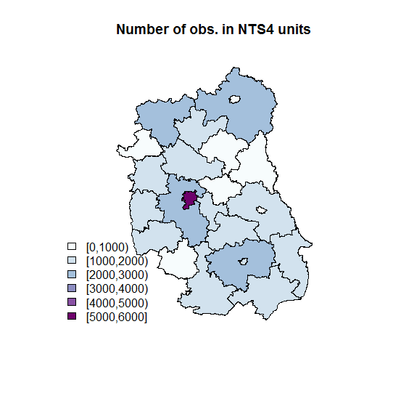

Slide 11
What else can be done?

Slide 12
Point data + shapefile
Distance
analysis
Just between points
Between cores and peripheries
Conversion to „polygon” data
Aggregated data by sectors and regions
Geometric representation of points
Just mapping
Ripley’s K function
Spatial interactions models
Measures of agglomeration and concentration
visualisation
e.g. representing points with circles
Spatial agglomeration measure
Spatial weights matrix
Spatial econometrics
dbmss, spatstat
sp, spdep, rgdal, maptools
???
sp, spdep, rgdal, maptools
spdep, splm, sphet…
???

Slide 13
Calculations based on distances

Slide 14
Distance analysis (1) just between points
xy<-cbind(dane$xgeo, dane$ygeo)
odle<-dist(xy)
odle.m<-as.matrix(odle)
odle.m[1:5, 1:5]
1 2 3 4 5
1 0.0000000 0.5888958 1.7076546 1.7991968 1.1537470
2 0.5888958 0.0000000 1.1920562 1.2116590 0.8085948
3 1.7076546 1.1920562 0.0000000 0.6301854 0.6981010
4 1.7991968 1.2116590 0.6301854 0.0000000 1.1367815
5 1.1537470 0.8085948 0.6981010 1.1367815 0.0000000

Slide 15
Distance analysis (2) just between points
Ripley’s K fuction uses the distances to get density curve (Marcon & Puech, 2003; Duranton & Overman, 2005; Do & Campante, 2009; Duranton & Overman, 2008; Marcon & Puech, 2009; Arbia, Espa, Giuliani & Mazzitelli, 2010)
library(spatstat) # more functions in dbmss package
bbb<-bbox(region)
min max
x 21.61554 24.14578
y 50.25183 52.28784
dane.ppp<-ppp(dane[,23], dane[,24], bbb[1,], bbb[2,])
plot(Kest(dane.ppp))

Slide 16
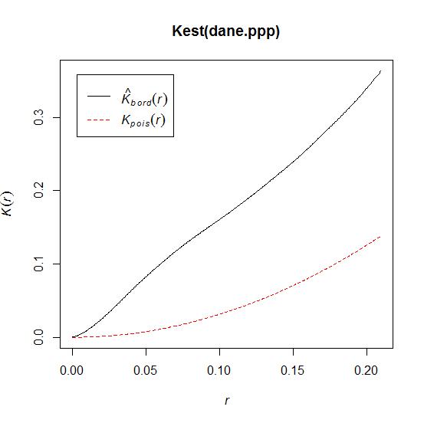
Ripley’s K function measurement of agglomeration

Slide 17
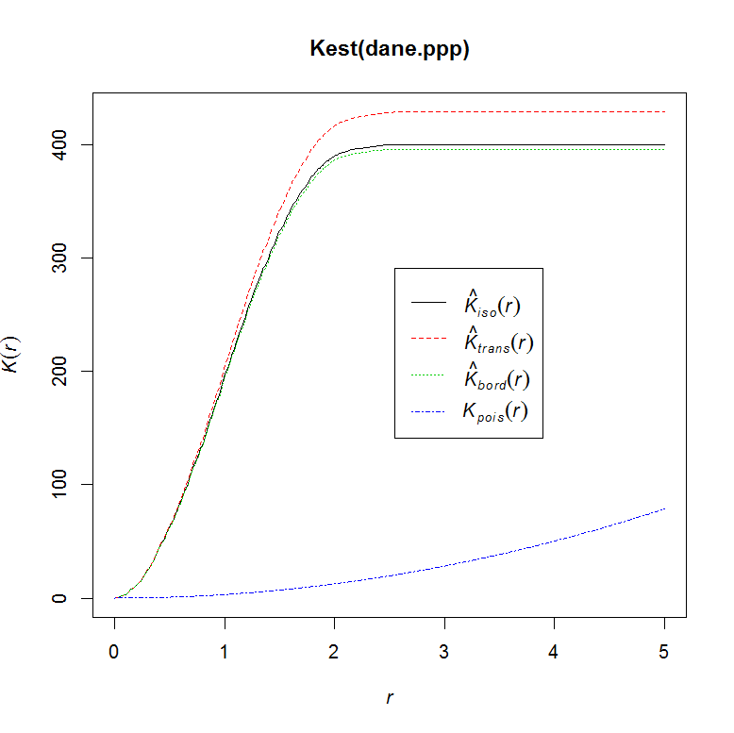
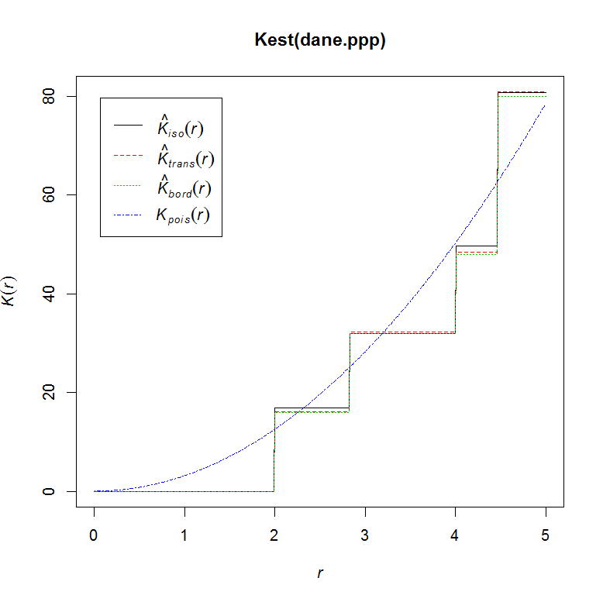
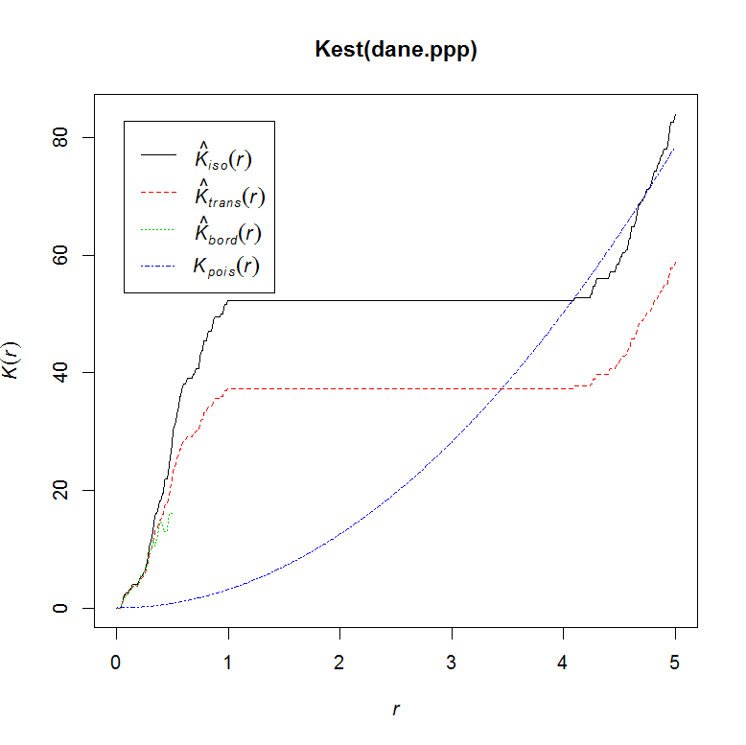
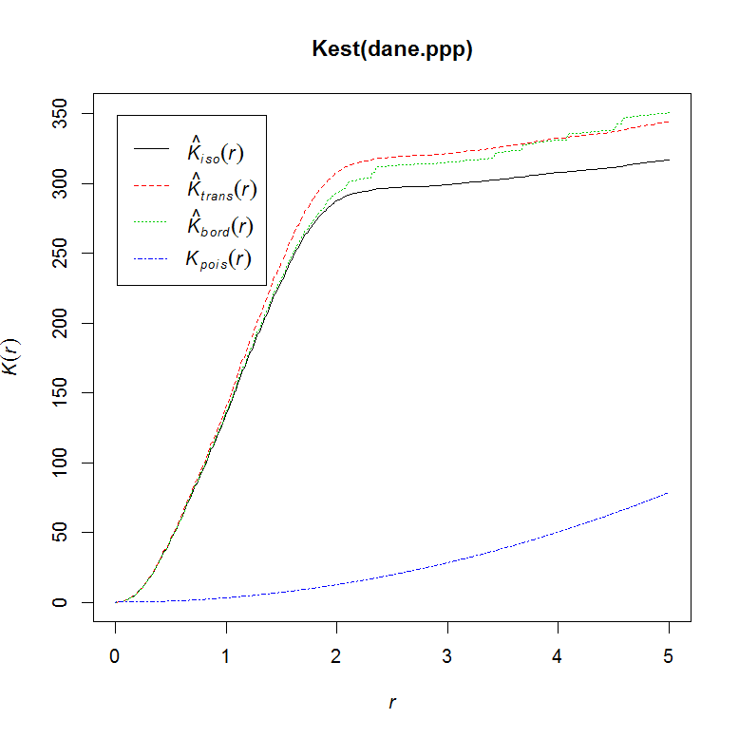
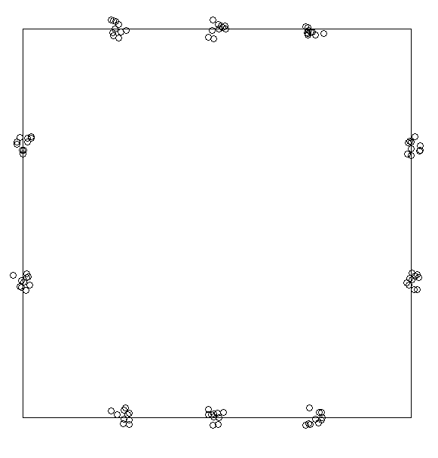

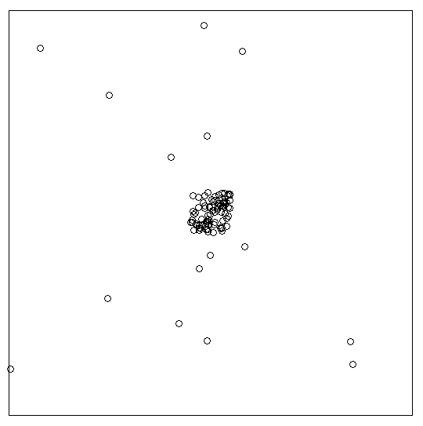
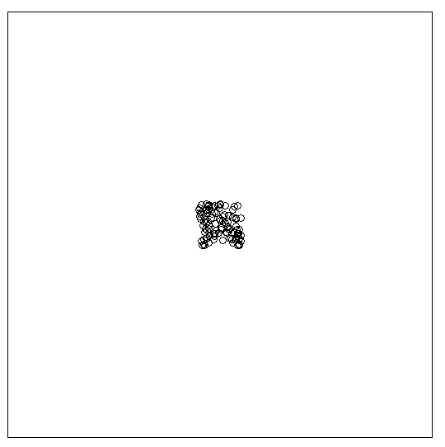
One could also generate some extreme point pattern to observe the behaviour of Ripley’s K

Slide 18
Distance analysis (4) just between points
It is also possible to calculate centroids and construct spatial weights matrix for region
crds.lublin<-coordinates(pow.lublin)
plot(pow.lublin)
points(crds.lublin, pch="*", col="red", cex=4)
cont.lublin.nb<-poly2nb(as(pow.lublin, "SpatialPolygons"))
plot(pow.lublin)
plot(cont.lublin.nb, crds.lublin, add=TRUE)
cont.lublin.listw<-nb2listw(cont.lublin.nb, style="W")

Slide 19
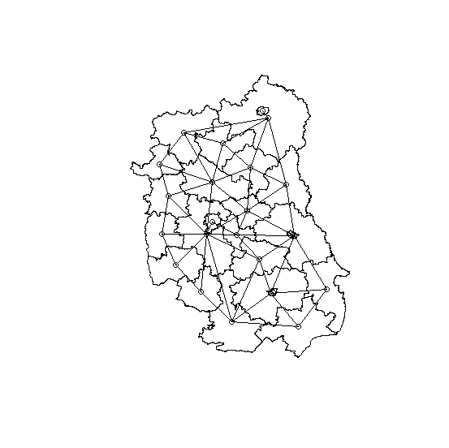
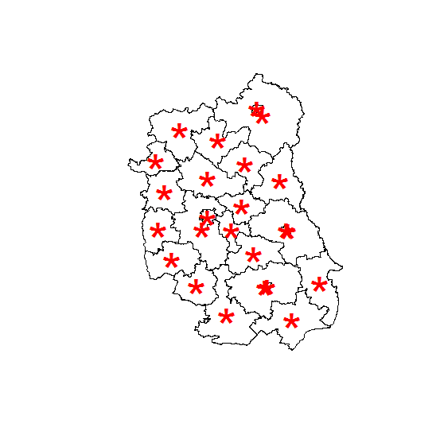
Centroids and contiguity links

Slide 20
Distance analysis (1) between core and periphery
Let’s set the coordinates of core regional city
library(SmarterPoland)
ad<-getGoogleMapsAddress(city = "Lublin", country="Poland", positionOnly = TRUE, delay=1)
ad
lat
http://maps.googleapis.com/maps/api/geocode/json?address=Banacha 2,+Lublin,+Poland&sensor=true 51.21639
lng
http://maps.googleapis.com/maps/api/geocode/json?address=Banacha 2,+Lublin,+Poland&sensor=true 22.6478 0
plot(pow.lublin)
points(crds.lublin, pch="*", col="red", cex=4)
points(ad[2], ad[1], pch="#", col="blue", cex=4)

Slide 21
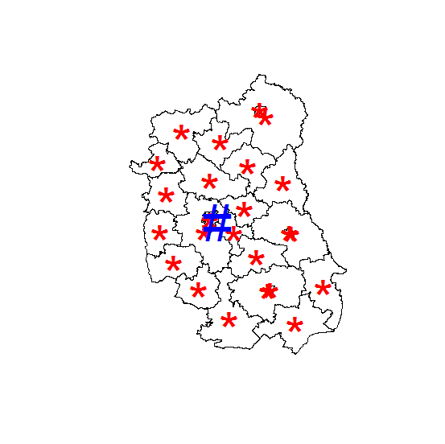
Core city of region

Slide 22
Distance analysis (2) between core and periphery
So one can get distance to core:
ad.m<-as.matrix(cbind(ad[2], ad[1]))
ad.m
[,1] [,2]
[1,] 22.6478 51.21639
core<-spDistsN1(crds.lublin, ad.m, longlat=TRUE)
core
[1] 92.900824 79.116755 60.586361 101.282310 56.543374 42.533632
[7] 48.685285 33.700291 13.874936 24.572003 78.588283 47.505026
[13] 51.236894 46.814644 64.224422 68.078241 16.147707 104.350009
[19] 96.722430 61.416239 69.598608 6.453943 59.126141 69.823553

Slide 23
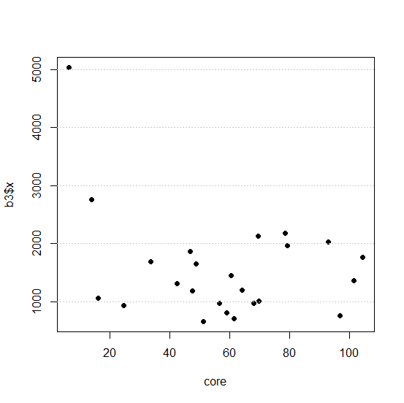
One can plot number of firms depending on the distance to core for powiats
plot(core, b3$x, pch=16)
abline(h=(1:5)*1000,
lty=3, col=„grey80")
X axis – distance to core
Y axis – aggregated numer
of firms by powiats

Slide 24
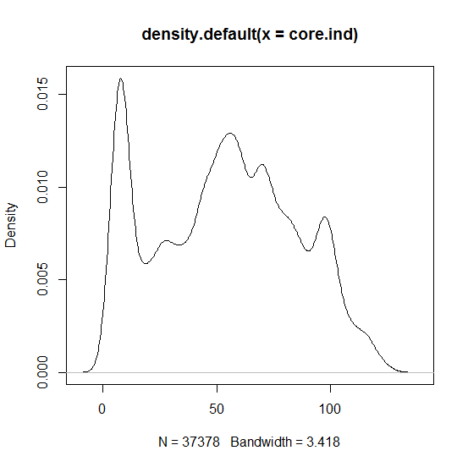
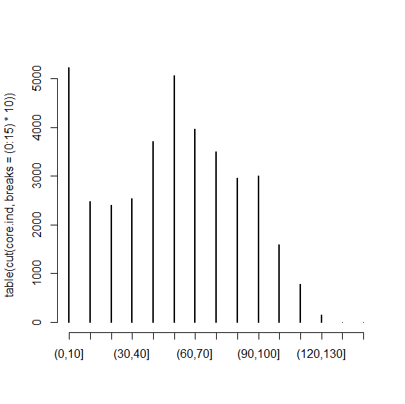
ind.dist<-as.matrix(cbind(dane[,23], dane[,24]), ncol=2)
core.ind<-spDistsN1(ind.dist, ad.m, longlat=TRUE)
plot(density(core.ind))
plot(table(cut(core.ind, breaks=(0:15)*10)))
Or for individual data

Slide 25
Calculations based on aggregated data
by region and sector

Slide 26
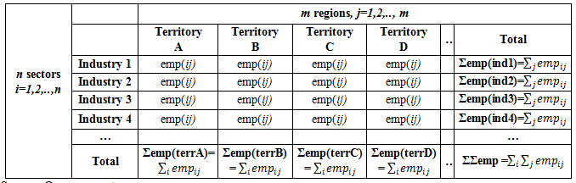
Concentration measures
Point data can be aggregated into two-dimentional table by regions and sectors
This opens the way to analyse the data with concentration measures

Slide 27
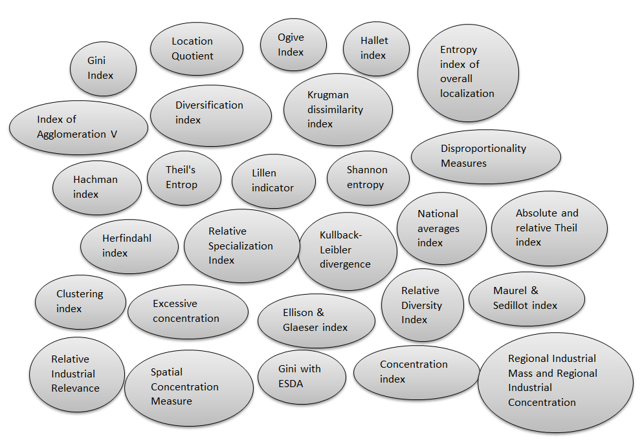
Cluster-based measures of over-& under- representation

Slide 28

Cluster-based measures of over-& under- representation
Details of these measures coming soon in our book:
Kopczewska K., Churski P., Ochojski A., Polko A. (2017), Measuring Regional Specialisation – A New Approach, palgrave macmillan / Springer

Slide 29
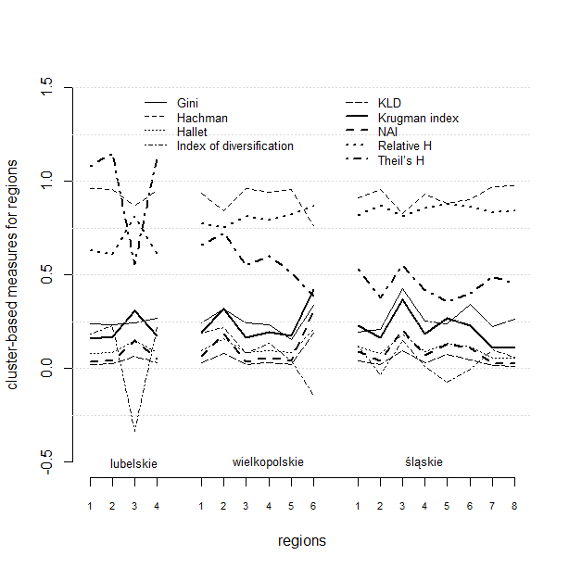
By sectors for regions

Slide 30
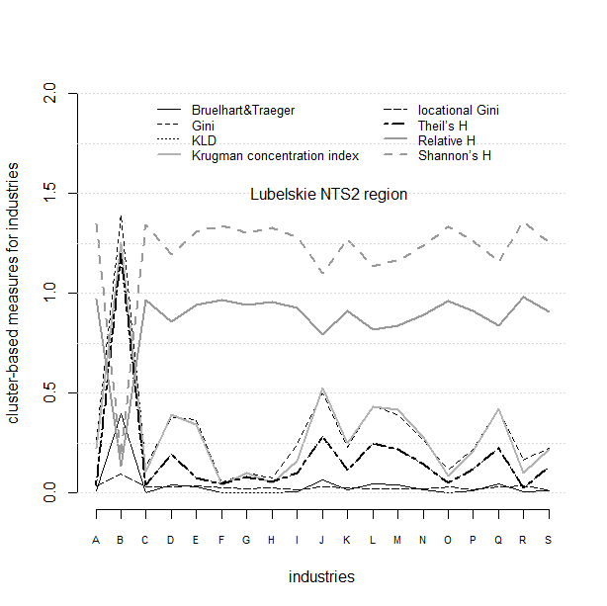
By regions for sectors

Slide 31
Measures of concentration (2) (over-& under- represnetation)
These measures still do not exist in R …
Codes are operationally ready - I am looking for cooperation to complete the package ☺

Slide 32
Last part: geometric representation of points
to measure the agglomeration pattern
with single number

Slide 33
Geometric represenation of points SPAG index of agglomeration (1)
What for? To measure the density of points located on the surface and to get single value as result
Spatial agglomeration index (SPAG) – when points are represented with circles* and check what percentage of area was covered by circles, also considering the distances between points and size of circles
* radii of circles optimised, so that area of single circle is proportional to employment in firm it represents, and total of areas of circles equals the area of region

Slide 34
Geometric represenation of points SPAG index of agglomeration (2)
null hypothesis:
firms are uniformely distributed over space (spatially uniform distribution = absolutely no agglomeration)
SPAG measures the degree of divergence from spatially uniform distribution pattern (so towards agglomeration or border dispersion)

Slide 35

Methodology of constructing SPAG measure
- The starting point is the geo-location of n business units.
By construction, index compares the empirical and theoretical distributions of circles representing firms.
In empirical distribution, each point (x,y) of n firms’ location is appointed by the circle, which area is proportional to employment empl_{i} in the company.
Radii r_{i} of n circles might be continuous variable for precise data on employment or discrete for interval data.
Sum of the a_{i} areas of n circles is equal to the area A of the region.
Radii of the circles create the business impact zones, which are automatically bigger in case of bigger firms.
Setting circles in real business locations is to reflect the phenomena of spatial agglomeration or other spatial patterns.
and and ( ) ~empirical
X

Slide 36
Methodology of constructing SPAG measure – why circles?
Why circles?
When characterizing point location and the magnitude of values in the point, one of the often proposed methods is to represent a point with a shape. This enables analysis on 2D surface. Measures of shape were well described over last sixty years.
Most of them are based on combination of perimeter and area. Shape matters for this combination as the shapes with the same perimeter can have different areas. The closer both these values the lower is the complexity of the shape and the measure is closer to the simple Euclidean geometry (de Smith et al., 2015).
It can be proven that shape which has the biggest area at given perimeter is a circle. Thus circle has the smallest difference between area and perimeter, so is the least complex shape.
Circular shape also gives the border values of many measures of shape (e.g. perimeter^2/area, compactness ratio, fractal dimension index), what guarantees the dimensionless (independence of size of the polygon).
Circle as simple shape is symmetric, can be inscribed in or circumscribed about other figures and solves the isoperimetric problem (de Floriani & Spagnuolo, 2008).
As most of the exercises in geography of shapes and in computational geometry is to simplify the shape, a circle-based measure is in this mainstream.
X

Slide 37
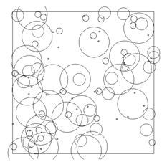
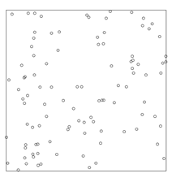
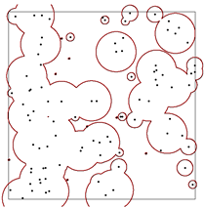
Geometric represenation of points SPAG index of agglomeration (4)
I_{coverage­} = 1
I_{distance} = 1.03
I_{overlap} = 0.69
SPAG = 0.72
Geo-locations of firms
Circles representing size of firms
Total area of region coverd by impact zones of business
SPAG = I_{coverage} * I_{distance} * I_{overlap}
$$SPAG=\frac{Area of circles select.}{Area of region}∗\frac{average dist.empiric.}{average dist.theor.}∗\frac{area of union empiric.}{area of union theor.}$$

Slide 38
Geometric represenation of points SPAG index of agglomeration (5)
To reflect all possible localization scenarios, the construction of SPAG includes three elements:
a) coverage of territory by circles, to enable calculations of relative coverage, with selected sector in relation to all business units
b) average distance between locations, to cover the extreme effects of full concentration and border-dispersed points, as well to distinguish between non overlapping circles strongly dispersed and tightly located
c) the ratio of overlapping circle areas, to measure the degree of departure from spatially uniform (non-overlapping) distribution towards full concentration in single point.
Reference value SPAG=1 is for the same size companies distributed evenly over the territory.
Values of SPAG<1 reveal patterns of clustering, with extreme value SPAG~0 at one-point cluster.
Values of SPAG>1 prove the existence of border-dispersed pattern and the mechanisms of repulsion.

Slide 39
Simulation results for n=100 firms four classes of companies’ size with equal frequency distribution of size
I_{coverage­} = 1 I_{distance} = 1.03 I_{overlap} = 0.69 SPAG = 0.72 | I_{coverage­} = 1 I_{distance} = 1 I_{overlap} = 0.74 SPAG = 0.74 | I_{coverage­} = 1 I_{distance} = 0.1 I_{overlap} = 0.08 SPAG = 0.008 | I_{coverage­} = 1 I_{distance} = 1.31 I_{overlap} = 0.44 SPAG = 0.57

Slide 40
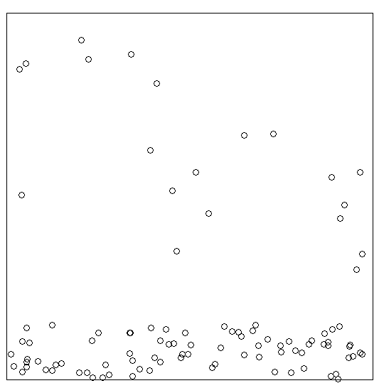
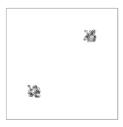
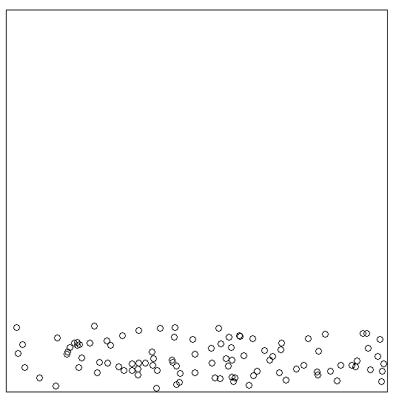
Simulation results for n=100 firms four classes of companies’ size with equal frequency distribution of size
I_{coverage­} = 1 I_{distance} = 0.61 I_{overlap} = 0.28 SPAG = 0.17 | I_{coverage­} = 1 I_{distance} = 0.89 I_{overlap} = 0.46 SPAG = 0.41 | I_{coverage­} = 1 I_{distance} = 0.26 I_{overlap} = 0.23 SPAG = 0.06 | I_{coverage­} = 1 I_{distance} = 0.74 I_{overlap} = 0.13 SPAG = 0.1

Slide 41
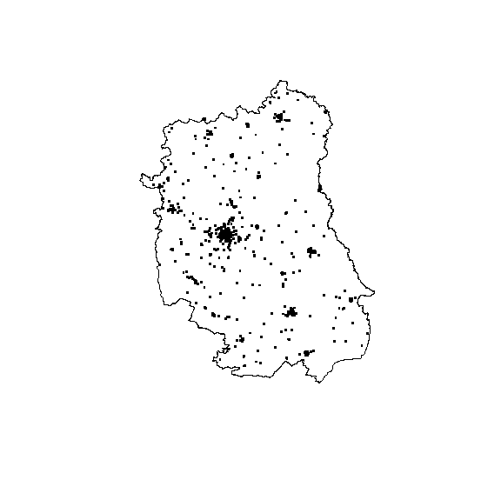
Most interesting elements of this analysis (1)
# just plotted points
plot(region)
points(xy, pch=".", cex=3)

Slide 42
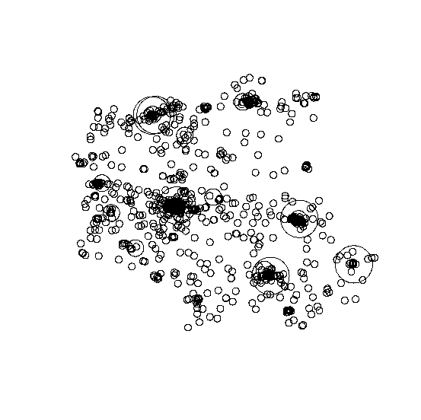
Most interesting elements of this analysis (2)
# circles o radius r instead of points
library(rgeos)
xy<-cbind(dane$xgeo,
dane$ygeo)
xy.sp<- SpatialPoints(xy)
circles.sel<-gBuffer(xy.sp,
quadsegs=50, byid=TRUE,
width=dane$r)
plot(circles.sel)

Slide 43
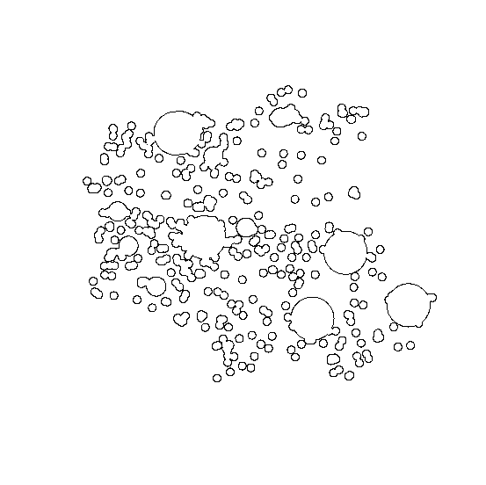
Most interesting elements of this analysis (3)
# union of overlapping geometries
library(rgeos)
pol.sel<-gUnaryUnion(circles.sel)
area.circles.sel<-
pol.sel@polygons[[1]]@area
plot(pol.sel)

Slide 44
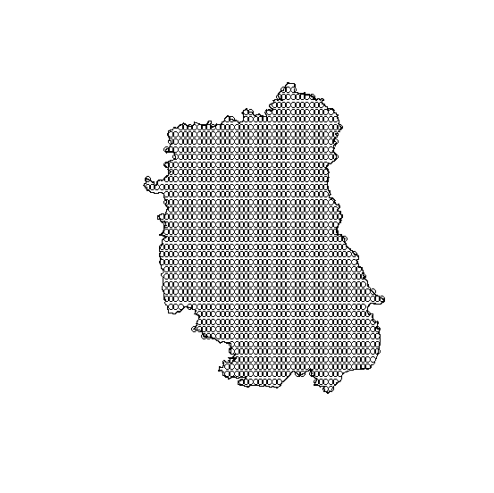
Most interesting elements of this analysis (4)
# spatial sampling inside the region
library(sp)
loc.teoret.sel<- spsample(region,
3000, type="regular")
plot(region)
points(loc.teoret.sel)

Slide 45
Empirical analysis for NTS2 regions in Poland
We used inidividual geo-located data for firms (one NTS2 region is ca.0.5 mln points) in cross-sections by NTS3, sectors, high-tech industries etc.
Even if for uniform distribution expected value of SPAG is 1, it is unattainable in reality. Empirical analysis of real locations suggests intervals like this:
→ As a relatively uniform distribution of the territory should be treated SPAG >= 0.25.
→ SPAG < 0.1 should be treated as spatial agglomeration

Slide 46
REGON codes for industries
A Agriculture, forestry, hunting and fishing,
B Mining and exploration,
C Industrial processing,
D Producing and supplying in electricity, gas, steam, hot water and air conditioning systems,
E Water supply; wastewater management, waste management and remediation activities,
F Construction,
G Wholesale and retail trade; repair of motor vehicles and motorcycles,
H Transportation and storage,
I Activities related to accommodation and catering services,
J Information and communication,
K Financial and insurance activities,
L Activities related to real estate services,
M Professional, scientific and technical activities,
N Administration and support service activities,
O Public administration and defense; compulsory social security,
P Education,
Q Healthcare and social assistance,
R Activities related to arts, entertainment and recreation,
S Other service activities,

Slide 47
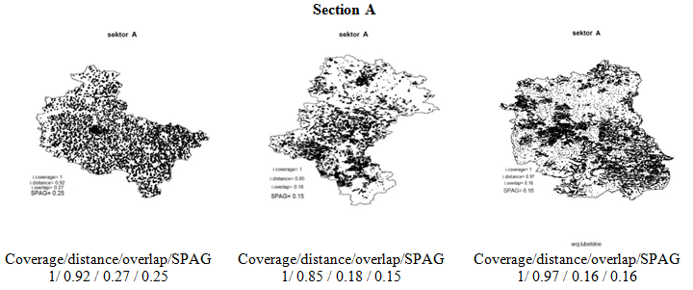
SPAG for NTS2 regions close to uniform distribution Agriculture
well dispersed intermediately agglomerated intermediately agglomerated
Wielkopolskie Śląskie Lubelskie

Slide 48
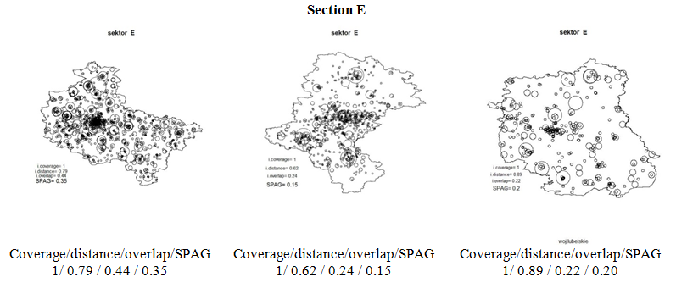
SPAG for NTS2 regions close to uniform distribution Water supply; wastewater management, waste management and remediation activities
well dispersed intermediately agglomerated rather dispersed
Wielkopolskie Śląskie Lubelskie

Slide 49
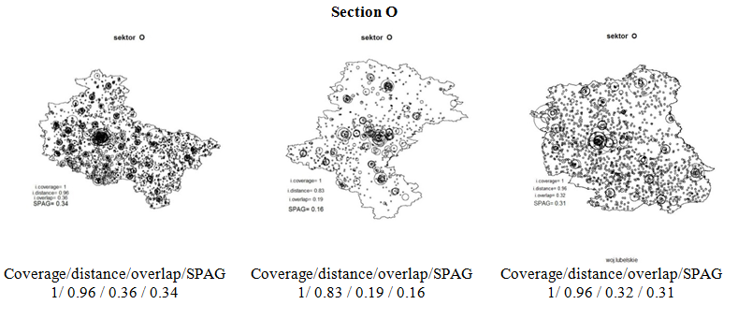
SPAG for NTS2 regions close to uniform distribution Public administration and defense; compulsory social security,
well dispersed intermediately agglomerated well dispersed
Wielkopolskie Śląskie Lubelskie

Slide 50
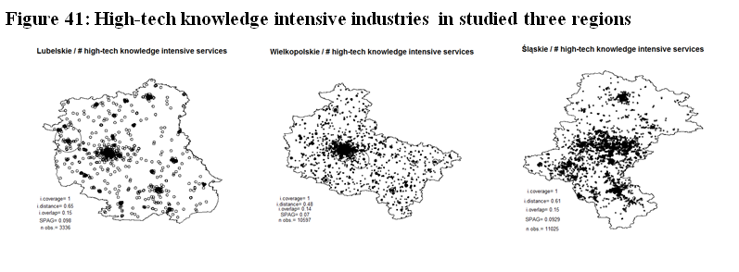
SPAG for NTS2 regions
Agglomerated agglomerated agglomerated
 | High-tech knowledge intensive industries
 | Lubelskie | Wielkopolskie | Śląskie
Coverage | 1 | 1 | 1
Distance | 0.65 | 0.48 | 0.61
Overlap | 0.15 | 0.14 | 0.15
SPAG | 0.10 | 0.07 | 0.09
No of obs | 3336 | 10597 | 11025

Slide 51
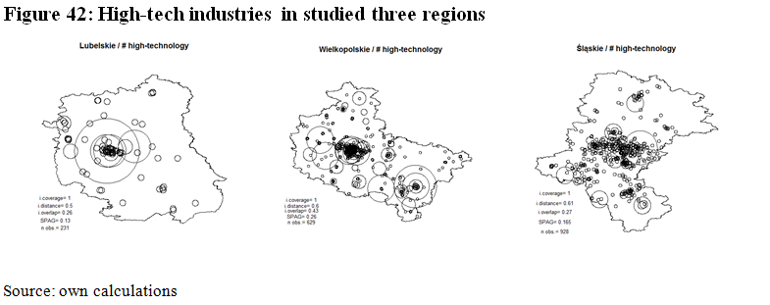
SPAG for NTS2 regions
Rather agglomerated well dispersed intermediate pattern
 | High-tech industries
 | Lubelskie | Wielkopolskie | Śląskie
Coverage | 1 | 1 | 1
Distance | 0.5 | 0.6 | 0.61
Overlap | 0.26 | 0.43 | 0.27
SPAG | 0.13 | 0.26 | 0.17
No of obs | 231 | 629 | 928

Slide 52
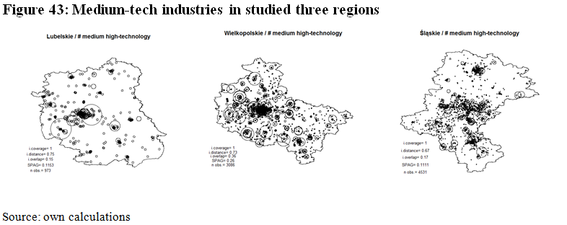
SPAG for NTS2 regions
agglomerated well dispersed agglomerated
 | Medium-tech industries
 | Lubelskie | Wielkopolskie | Śląskie
Coverage | 1 | 1 | 1
Distance | 0.75 | 0.73 | 0.67
Overlap | 0.15 | 0.36 | 0.17
SPAG | 0.11 | 0.26 | 0.11
No of obs | 973 | 3086 | 4531

Slide 53
SPAG Index of spatial agglomeration
Details of this measure also are coming soon in our book:
Kopczewska K., Churski P., Ochojski A., Polko A. (2017), Measuring Regional Specialisation – A New Approach, palgrave macmillan / Springer

Slide 54
SPAG Index of spatial agglomeration
This measure also does not exist in R …
Codes are operationally ready - I am looking for cooperation to complete the package ☺

Slide 55
Thank you!

